Slide 1

Fantasy Cricket: Decoding the Game for Victory
Jithendhar Karukola

Slide 2
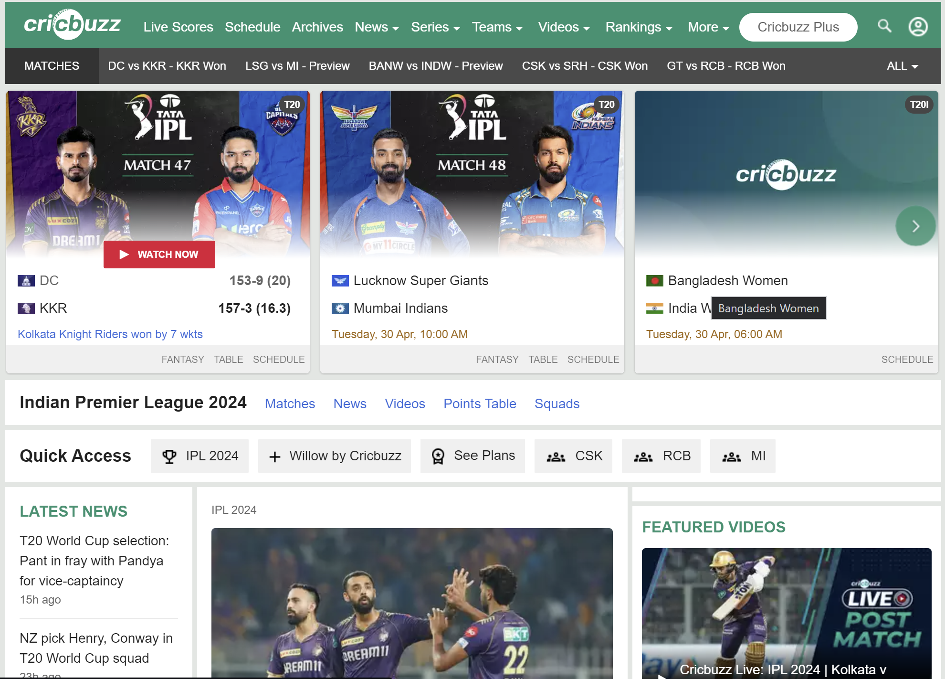
CRICBUZZ
Fantasy cricket is an online game where players are selected based on field performance to earn points and win real money, with higher scores resulting in more money.
Cricbuzz recognizes the growing demand for personalized cricket content and wants to improve user experience and content recommendations to remain competitive in the ever-changing cricketing landscape.

Slide 3
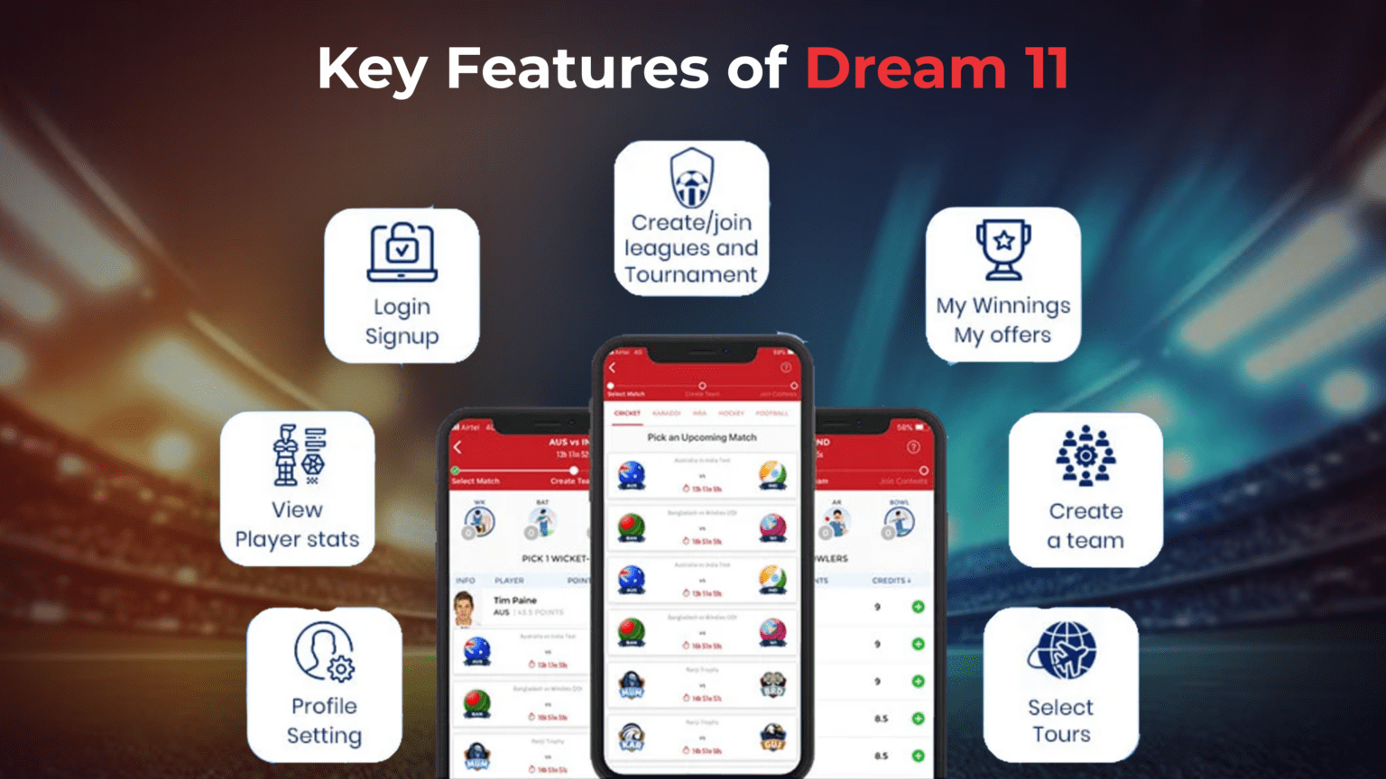
DREAM 11 – India's Biggest Sports Game
While Fantasy cricket has been there for a long time, it was in 2008 when the Indian Premier League was introduced that the cricket world was taken by storm
Dream11 was the first company in India to introduce the concept of Fantasy sports. Co-founders Harsh Jain and Bhavit Sheth started it in 2008. In 2012, they launched a freemium model of Fantasy cricket in India. Two years later, there were 1 million registered users on the app, which ballooned to 45 million in 2018. At present, there are over 140 million registered users on the app.
Fantasy cricket is poised to become a massive 2 billion$ market by FY25 in India.

Slide 4
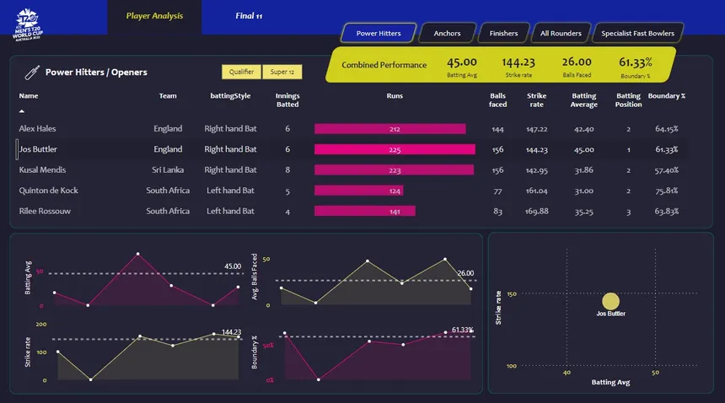
BUSINESS UNDERSTAANDING
Today, data analytics is playing an increasingly important role in sports, and cricket is no exception.
Data analytics in cricket is revolutionizing player performance, team strategy, and match outcomes. Utilizing machine learning algorithms and wearable devices, teams gain a competitive edge and improve game management.
By analyzing vast amounts of data, we can gain valuable insights into player performance, team strategies, and trends within the game. From the elegance of a perfectly timed shot to the thrill of a nail-biting finish, cricket offers a unique blend of skill, strategy, and drama.

Slide 5
DATASET
Cricket is a bat-and-ball game played between two teams of eleven players each on a cricket field, at the center of which is a rectangular 20-meter (22-yard) pitch with a target at each end called the wicket (a set of three wooden stumps upon which two bails sit). Each phase of play is called an innings, during which one team bats, attempting to score as many runs as possible, whilst their opponents bowl and field, attempting to minimize the number of runs scored. When each innings ends, the teams usually swap roles for the next innings.
The dataset contains two files: bat.csv and bowl.csv containing data of players from 12 different teams in IPL, ODI, T20, and Test Cricket till 16 Jan 2021.
The Batting data consists of the following columns: Player Name(Player), Player Team(Team), Match Type(Type), Matches(M), Innings(Inn), Not Out(NO), Runs, Highest Score(HS), Batting Average(Avg), Bowls Faced(BF), Strike Rate(SR), 4s, 6s, 50, 100, 200
The Bowling data consists of the following columns: Player Name(Player), Player Team(Team), Match Type(Type), Matches(M), Innings(Inn), Bowls(B), Runs, Wickets(Wkts), Best Bowling in Innings(BBI), Best Bowling in Match(BBM), Economy Rate(Econ), Bowling Average(Avg), Strike Rate(SR), 5 Wicket(5W), 10 Wicket(10W)
Data has been extracted from Cricbuzz using python scripting and web scraping.

Slide 6
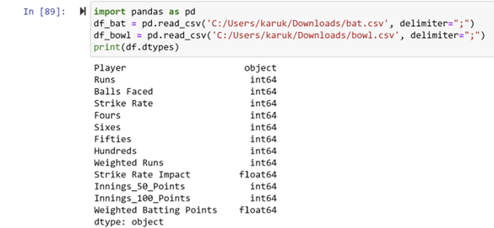
DATASET CONTND……
DATATYTPES
DATA INFO
There are 800+ rows in the dataset, and the columns..?
Read CSV files containing batting and bowling data into Pandas Data Frames (df_bat and df_bowl).
Printed basic information about the Data Frames (DATA STRUCTURES)

Slide 7
EXPLORING DATA STRUCTURE
LIBRARY USED - PANDAS: This versatile library excels at data manipulation and analysis. It allows us to load data from CSV files, clean and transform it, and perform various operations to prepare it for further exploration and visualization.
To understand the data structure, we'll leverage two key Pandas methods:
Head(n): This method displays the first 'n' rows of the Data Frame, giving us a glimpse into the data's format and content. For instance, .head() might show us columns like "Player", "Runs", "Strike Rate", and "Year".
Describe(): This method provides summary statistics for numerical columns in the Data Frame. It calculates measures like mean, minimum, and maximum values for each numeric column. These statistics help us understand the central tendency (average values) and spread (variation) within the data.

Slide 8

DATA CLEANING AND STANDARDIZATION:
Used One hot Coding for changing categorical variable to Numeric variables.
Split the concatenated column names into separate columns (df_bat.columns.str.split).
Standardized column names for both batting and bowling Data Frames.
Reset index to ensure continuity (reset_index).

Slide 9
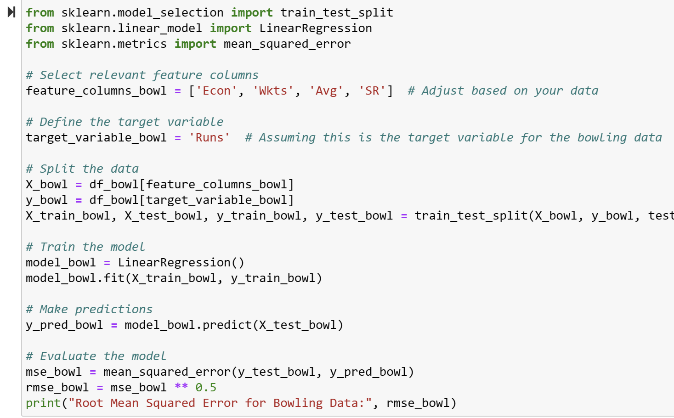
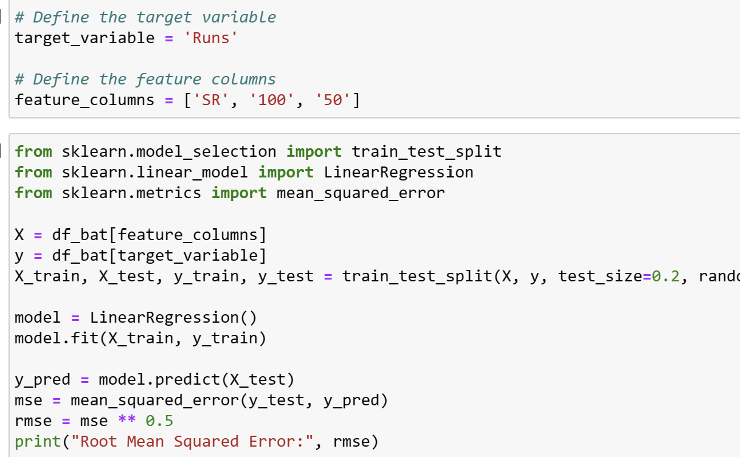
BUILDING A DATA MODEL
Predicting Runs with Linear Regression: I have employed linear regression, a statistical method that allows us to create a model that predicts a batsman's runs based on other relevant batting metrics. Think of it as a formula that considers factors like strike rate, centuries, or fifties and estimates the number of runs a batsman might score based on those values. This helps us identify which factors are most important for scoring runs.
To assess how well the model predicts runs, I have used a metric called Mean Squared Error (MSE).MSE measures the average squared difference between the actual runs scored and the runs predicted by the model. A lower MSE indicates a more accurate model.

Slide 10
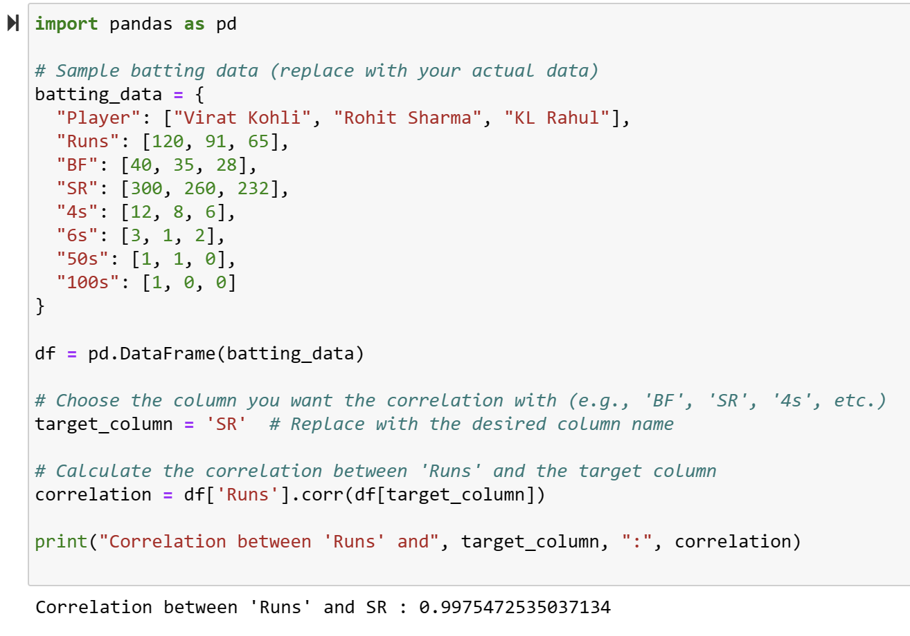
CORRELATION ANALYSIS
Calculated correlation coefficients between 'Runs' and other batting statistics. This reveals how strongly variables are related (positive, negative, or no correlation).A high positive correlation between runs and strike rate might suggest batsmen with higher strike rates tend to score more runs.

Slide 11
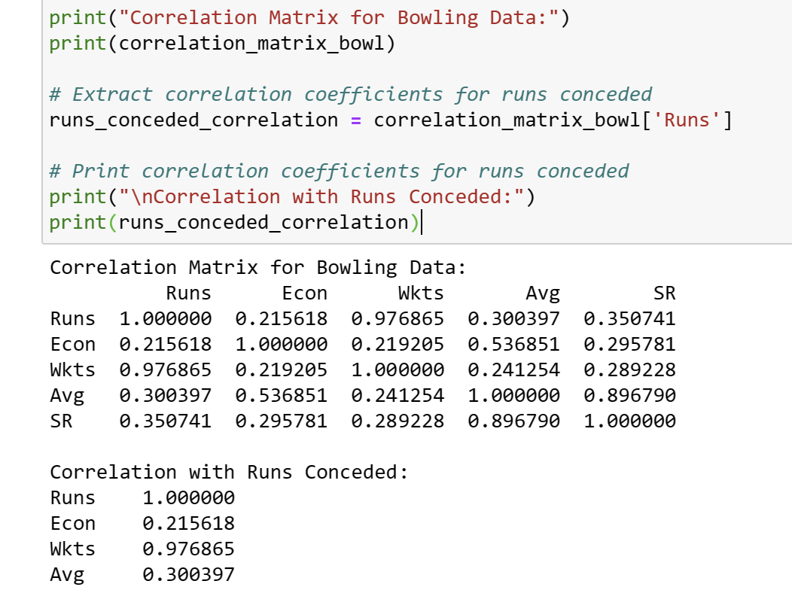
CORRELATION ANALYSIS CNTND……
Calculated correlation coefficients between 'Runs Conceded' and other bowling metrics. This reveals how bowling performance factors relate to runs conceded (positive, negative, or no correlation).

Slide 12
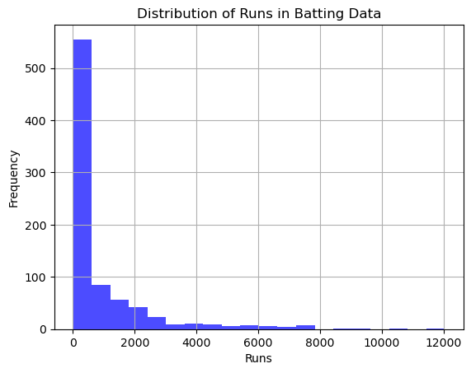
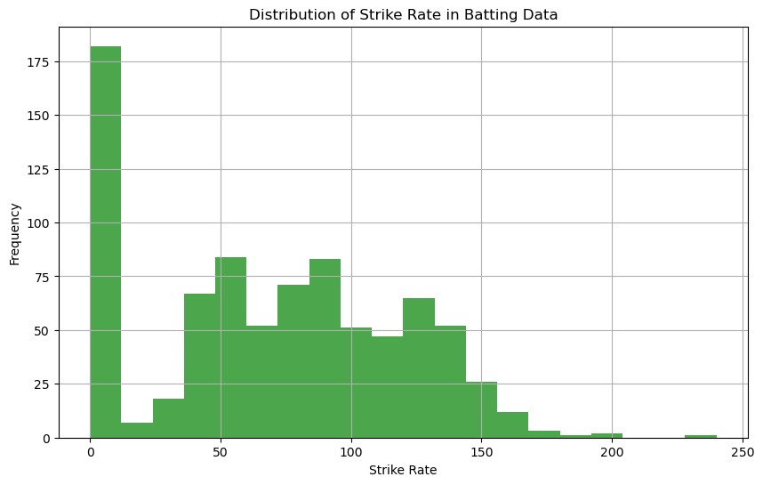
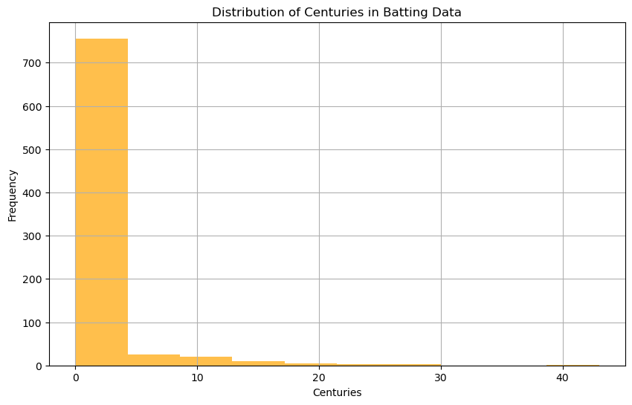
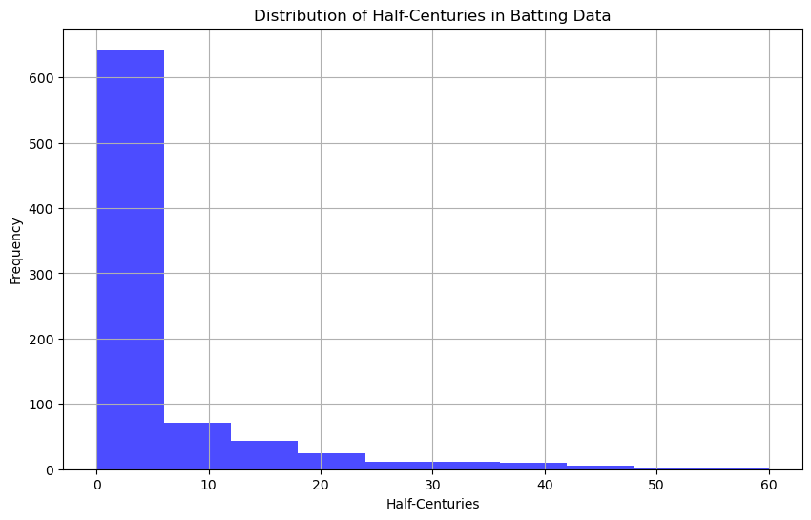
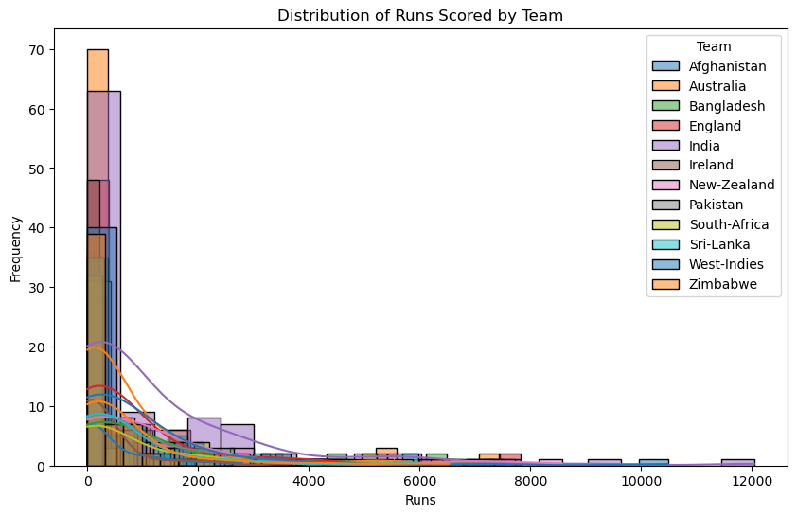
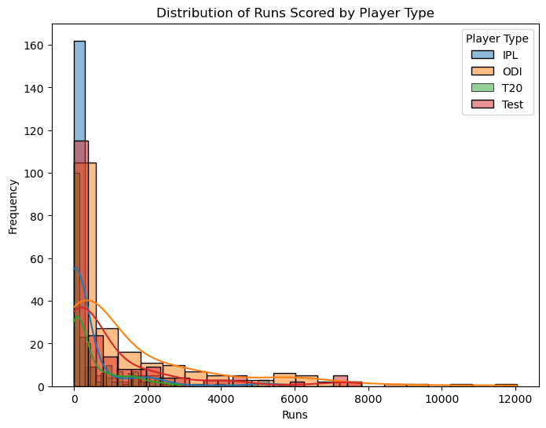
DATA VISUALIZATIONS ( BATTING)

Slide 13
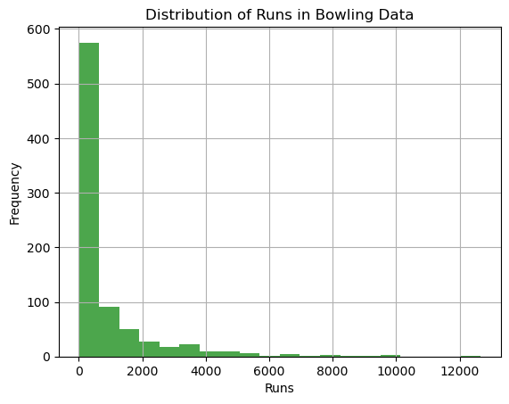
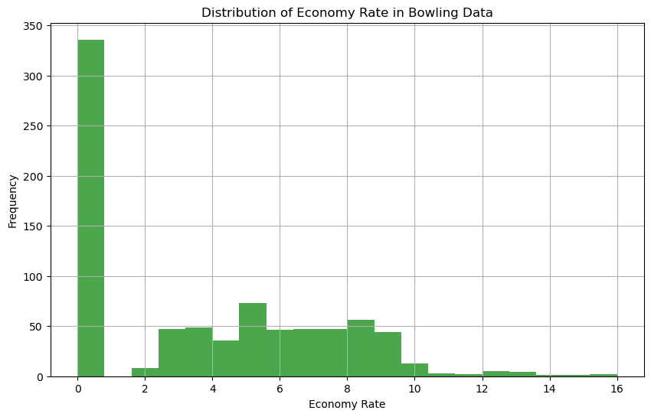
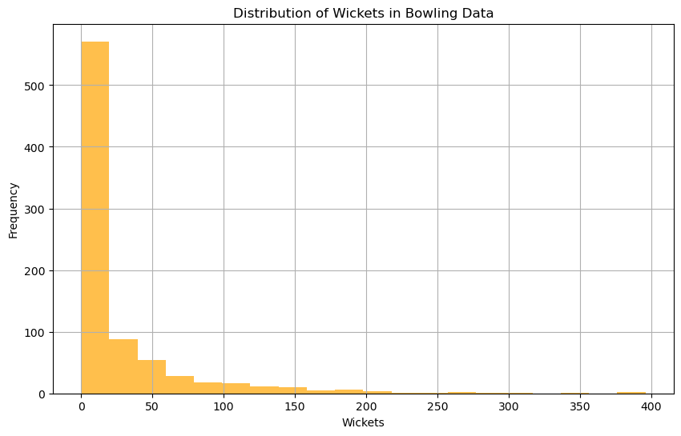
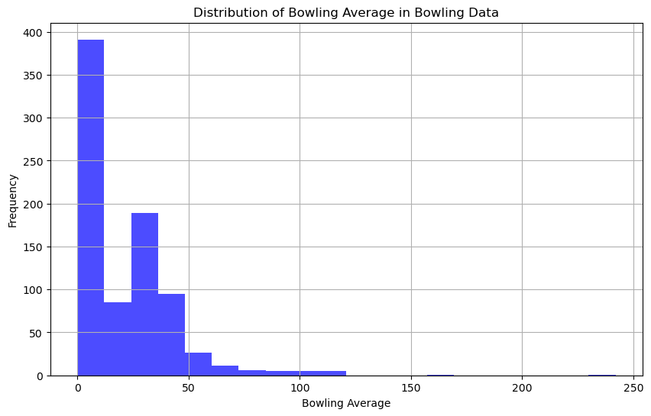
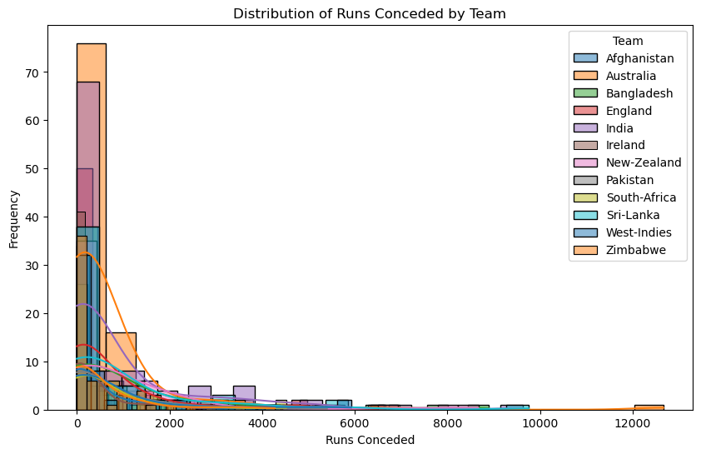
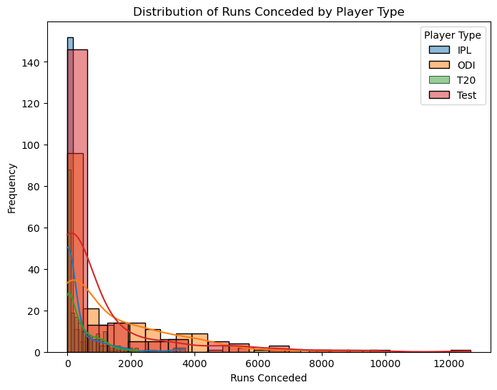
DATA VISUALIZATIONS ( BOWLING)

Slide 14
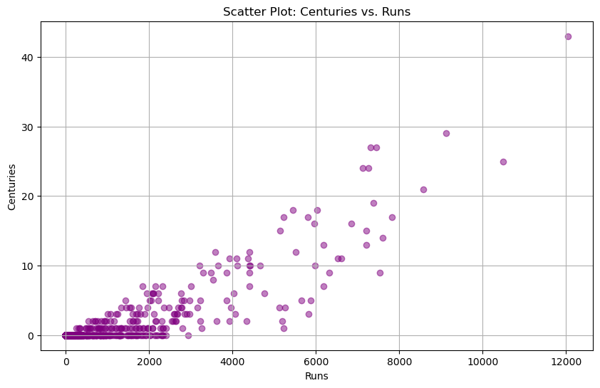
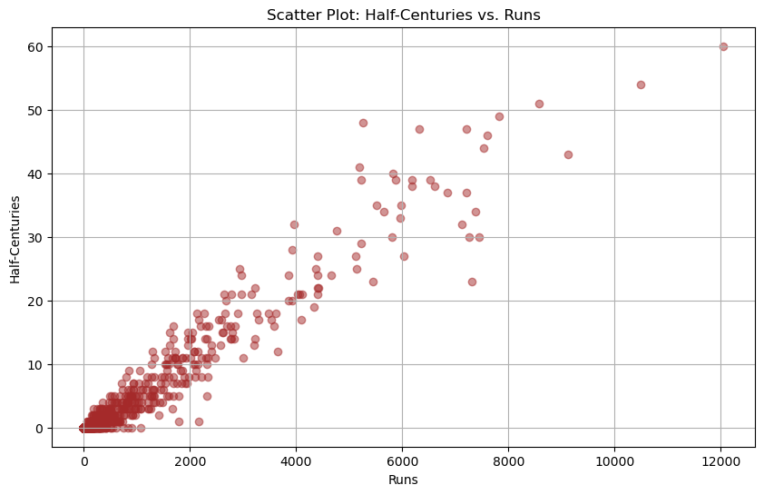
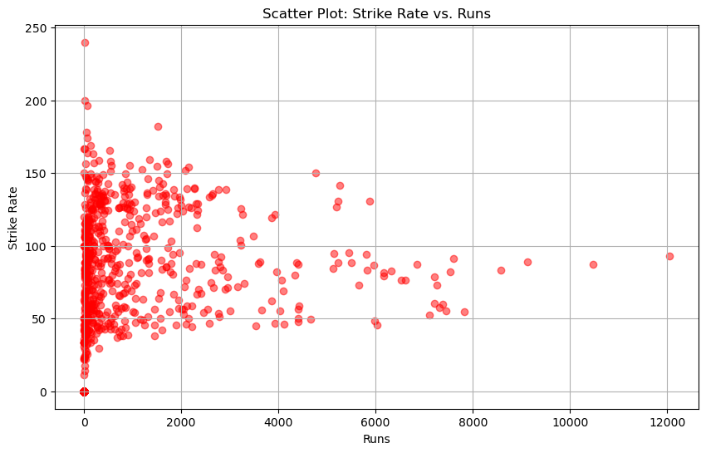
SCATTER PLOT( BATTING)

Slide 15
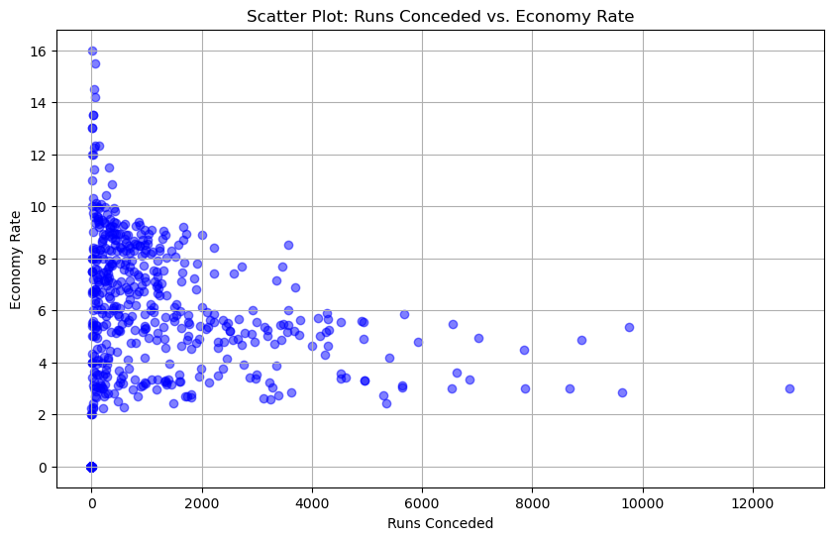
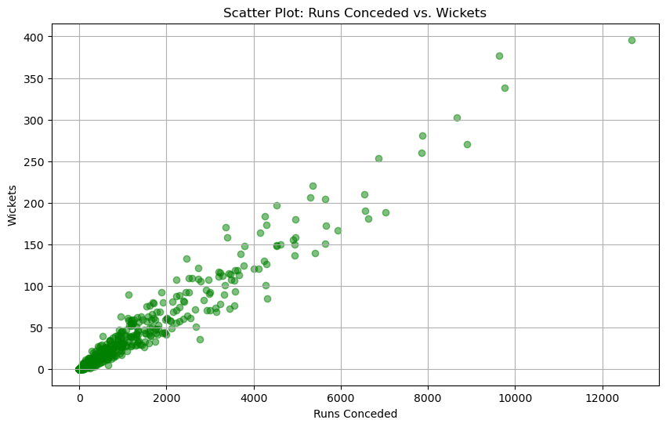
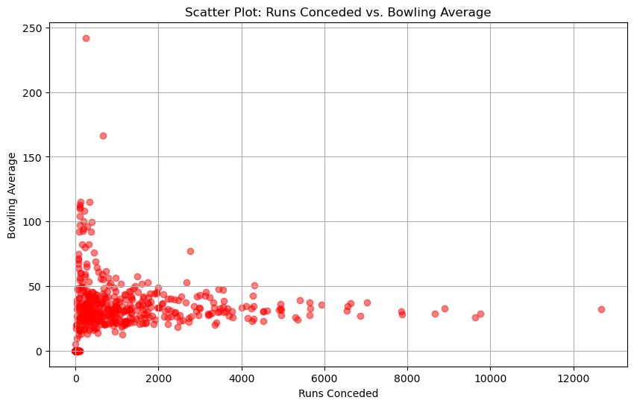
SCATTER PLOT( BOWLING)

Slide 16
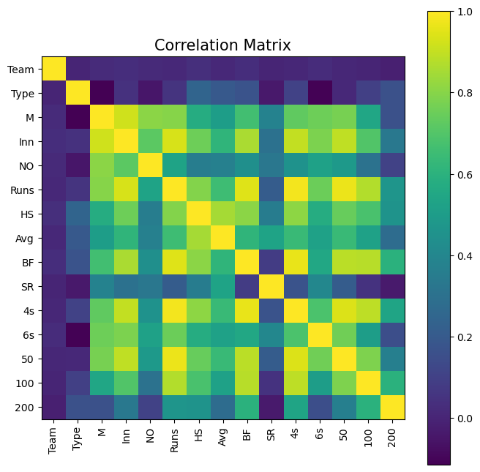
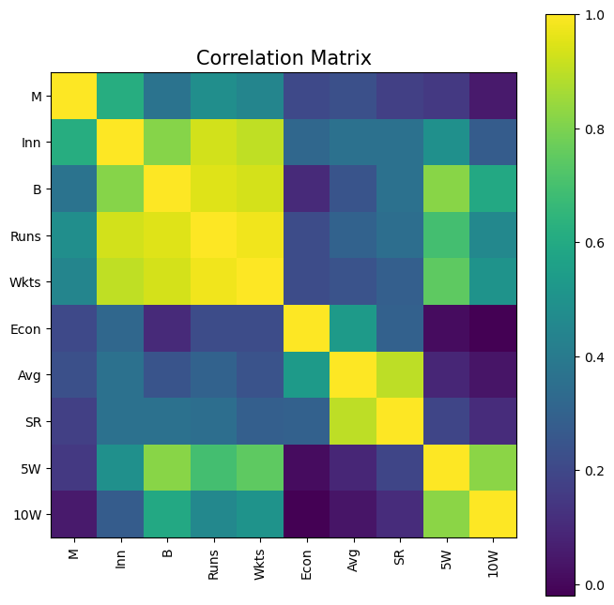
CORRELATION MATRIX

Slide 17
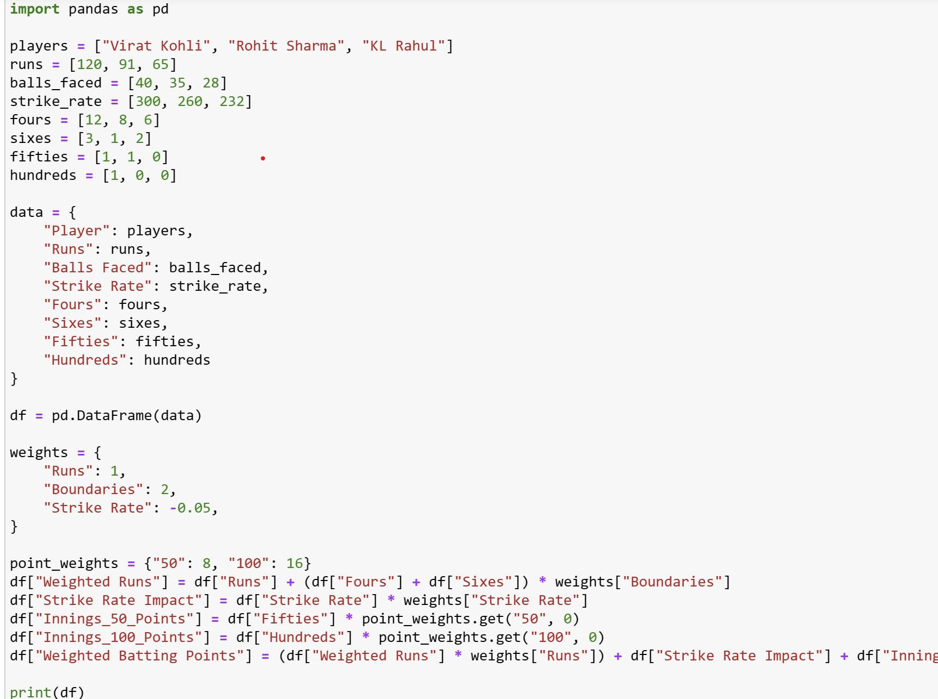
WEIGHTED POINTS (BAT)
The analysis provides valuable pointers for player selection . By understanding which factors have the most significant impact on run scoring or run restriction, we can make more informed decisions when selecting players for the team.

Slide 18
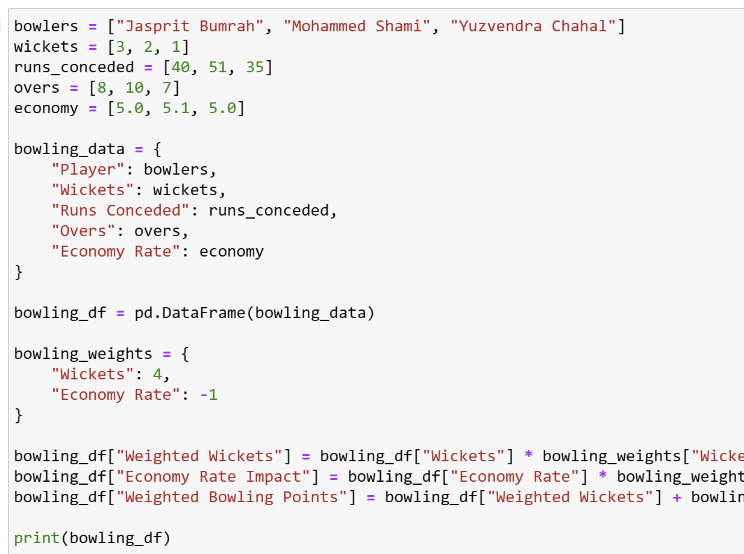
WEIGHTED POINTS (BOWL)
The analysis can also guide strategic decision-making during matches.
For example, if you identify a bowler who concedes more runs when their economy rate is high, you might deploy them for shorter spells to limit the damage.
Similarly, understanding a batsman's weaknesses based on correlations between batting metrics can help bowlers devise targeted strategies to get them out.

Slide 19
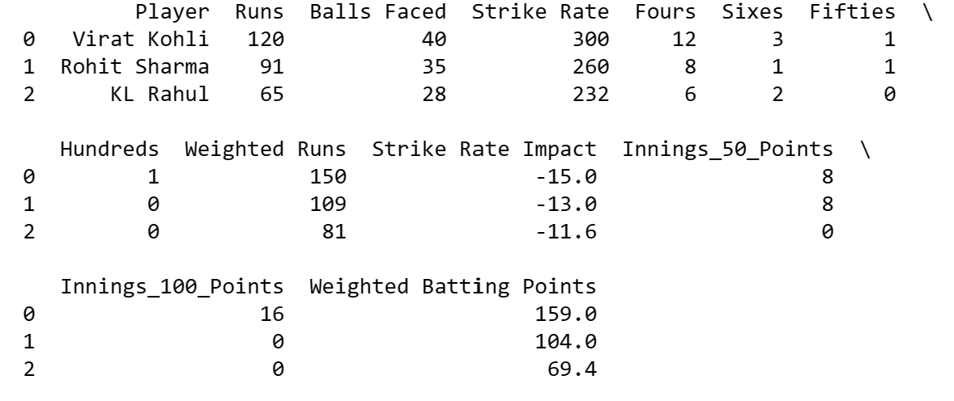
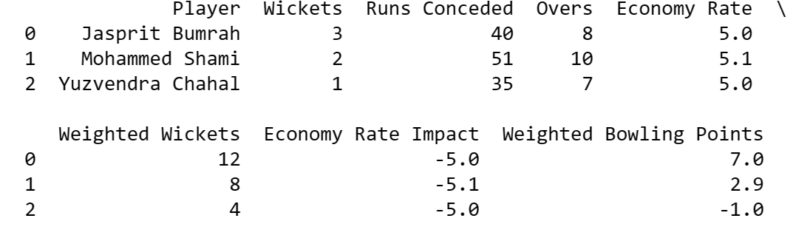
RECOMMENDATIONS
Strategic Team Building: By incorporating weighted player points into selection process, we can build well-balanced Dream11 teams that consider both batting and bowling prowess.
Leveraging insights for Dream11:We can utilize the concept of weighted player points specifically for Dream11 team building.

Slide 20
CONCLUSION
Data analysis has revolutionized the way we approach cricket, it empowers us to make informed decisions in cricket.
Moving beyond averages, we gain a deeper understanding of player performance.
These insights can be applied to player selection, strategy development, and improve fantasy cricket.
As we embrace data-driven decision-making, we unlock new possibilities for maximizing success on the cricket field.

Slide 21


